Slide 1

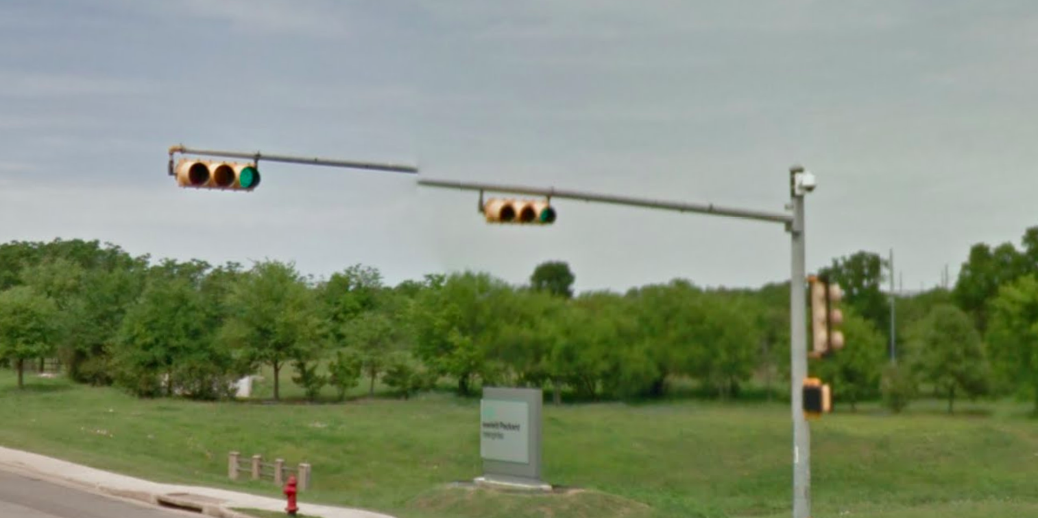
Austin Transportation Department Signs Work Orders
Created By: Susanne Gov Created Date: 2020-08-10 Location Name: WELLS BRANCH PKWY / SUMMIT DR Intersection ID: 5162458 Cardinal Direction: N Work Order ID: SG-20589
Sign Type | Install/Remove

Slide 2
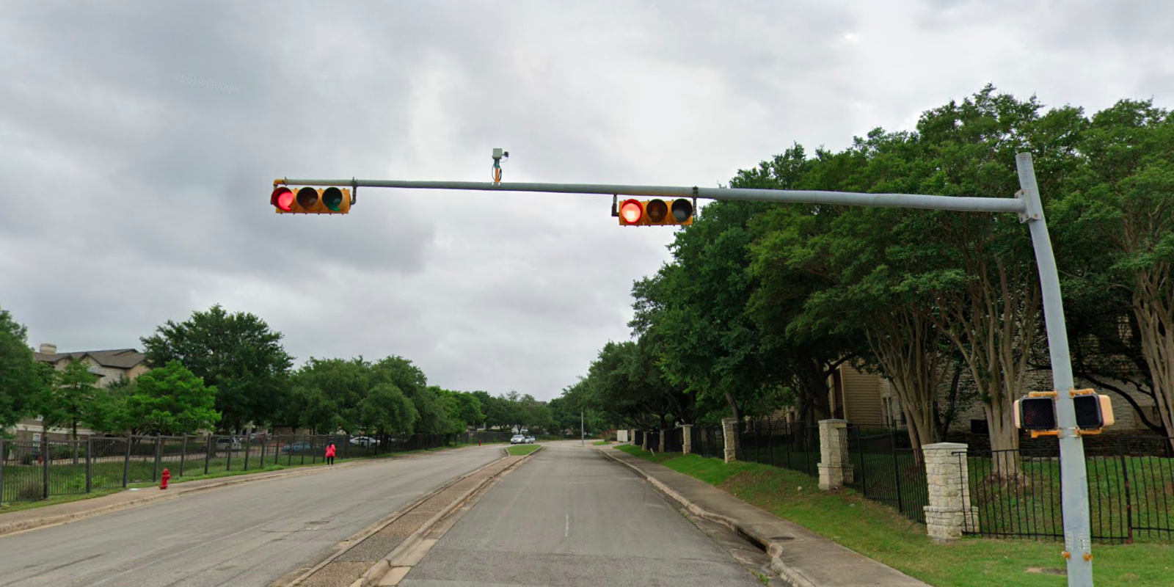
Austin Transportation Department Signs Work Orders
Created By: Susanne Gov Created Date: 2020-08-10 Location Name: WELLS BRANCH PKWY / SUMMIT DR Intersection ID: 5162458 Cardinal Direction: S Work Order ID: SG-20589
Sign Type | Install/Remove

Slide 3
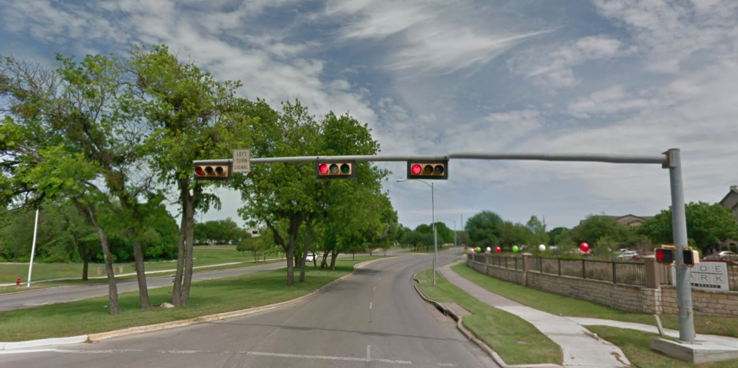
Austin Transportation Department Signs Work Orders
Created By: Susanne Gov Created Date: 2020-08-10 Location Name: WELLS BRANCH PKWY / SUMMIT DR Intersection ID: 5162458 Cardinal Direction: E Work Order ID: SG-20589
Sign Type | Install/Remove
Left Turn Signal | Remove

Slide 4
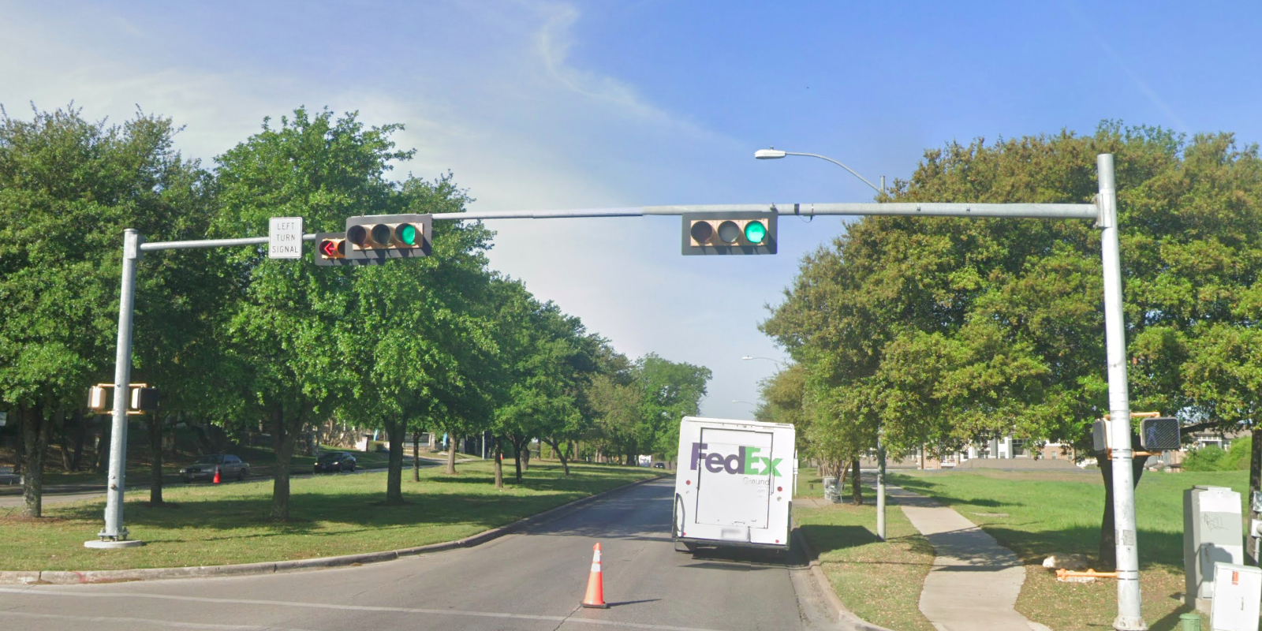
Austin Transportation Department Signs Work Orders
Created By: Susanne Gov Created Date: 2020-08-10 Location Name: WELLS BRANCH PKWY / SUMMIT DR Intersection ID: 5162458 Cardinal Direction: W Work Order ID: SG-20589
Sign Type | Install/Remove
Left Turn Signal | Remove

